Slide 1












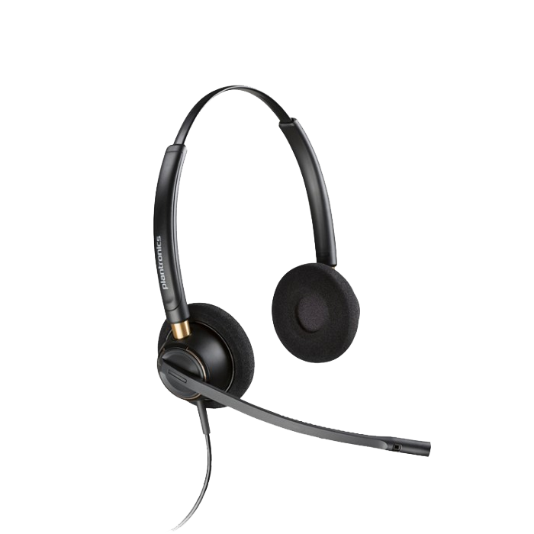



AWS Cloud
AWS Region
User’s local machine
Amazon Connect instance (existing)
Web browser
Plantronics Hub REST Service API
Global Region
SSL security
Optional custom domain name settings
Headset call control
Hosted zone (existing)
Poly-integrated Amazon Connect CCP web site
Plantronics Hub client application
Amazon Simple Storage Service
Amazon Route 53
Custom CNAME record
S3 Bucket loaded with Poly-integrated Amazon Connect CCP content
Amazon CloudFront
Scalable, highly available https web site distribution
User with Poly headset

